Slide 1
COMP 1531
Tutorial 7

Slide 2
Today’s Demos:
I’ve read everyone’s code and have done some preliminary marking so today is about filling in gaps with your demos based on some questions Matt and I have for your group.
You can leave after you are done.

Slide 3
Today’s Agenda:
Design Principles!
(There is Chocolate on offer today)

Slide 4
Design Concern - What Are Design Smells?
They aren’t bugs!
They are indicators that your code might not be maintainable in the future
Things that make code functionality difficult to extend, or change, later
If you see smells starting to emerge, you should be looking to refactor
“It’s very difficult to build a house on sand” - i.e. if you lay down a poorly designed base structure of code, you will find yourself hacking together solutions later in a super ineffective way, and it only gets harder as you get further through a project

Slide 5
Refactoring: is not about fixing errors, because smells are not bugs
Definition: changing the structure of existing code to make it easier to accommodate future changes and extensions
What it is NOT:
Adding features
Debugging
Changing inputs or outputs in any way
you write code -> test it -> debug and fix until the black box tests pass -> refactor -> the same tests should still pass

Slide 6
Common Design Smells:
Rigidity: hard to change the software, lots of interdependencies
Fragility: tendency for 1 small change to cause breakage in multiple places
Immobility: hard to reuse the code in other contexts
Viscosity: 2 types
Software: solutions are hacked together rather than well designed
Environmental: hard to get changes into production due to your workplace having a backlog of things to get done (not so important)
Opacity: hard to understand the code
Needless Complexity: over engineering/solutionism
Needless Repetition

Slide 7
How we are going to treat the smells:
DRY - Don’t Repeat Yourself
Less code is easier to maintain that more code
KISS - Keep it Simple Stupid
Easy to understand code is our friend
Top-Down Thinking: Only add things as they become needed. Top-down thinking says that when building capabilities, we should work from high levels of abstraction down to lower levels of abstraction.

Slide 8
Activity 1:
Break up into your project groups.
Spend 10 minutes together as a team looking through your iteration 2 code. Identify a segment of a file in your repository that you think is a design smell. After 10 minutes, your tutor will ask each group to point out the file/line(s) of where this is, what you think is wrong with it, and how you would improve the code design. I’ll get your project up on my computer so we can discuss as a class.

Slide 9
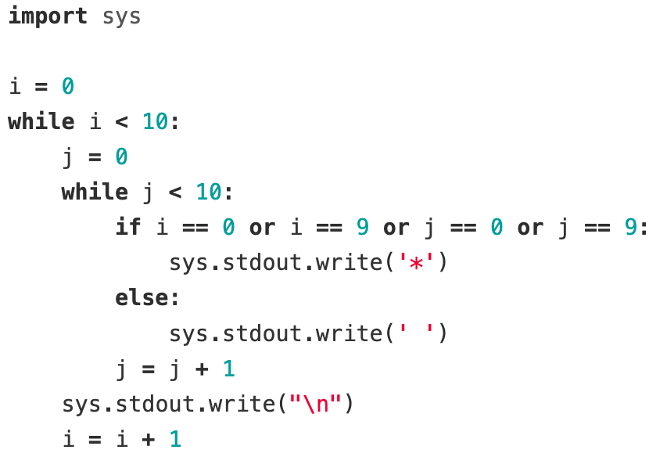
Activity 2:
A simple piece of code box.py that generates an ASCII box has been provided. What are possible code smells with this code? How would you refactor it to be more consistent with basic software engineering design principles?

Slide 10
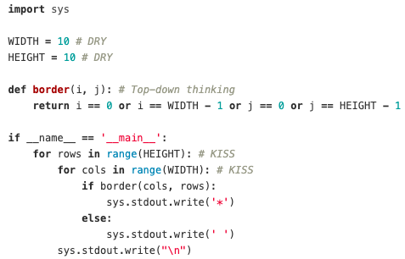
Activity 2:

Slide 11
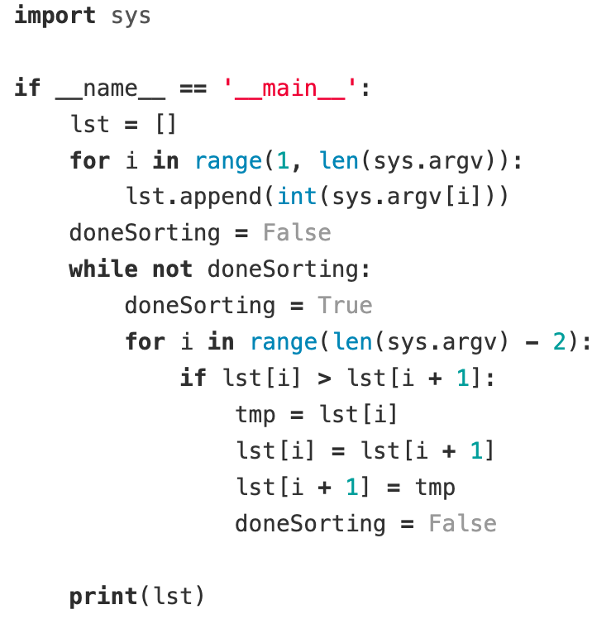
Activity 3:
A simple piece of code bubble.py that uses bubble sort to sort numbers passed in via argv has been provided. What are possible code smells with this code? How would you refactor it to be more consistent with basic software engineering design principles?

Slide 12
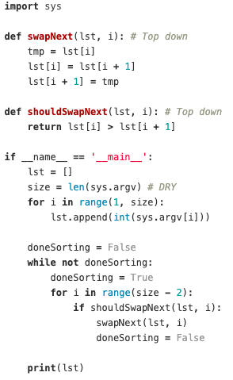
Activity 3:

Slide 13
Activity 4:
Use top-down thinking to implement a registration function in register.py for an social network where a new user enters a username, password, and the repeat password. To successfully register users must:
Enter a username that is not already taken
Enter a password of minimum 10 characters
Both password and repeat password match

Slide 14
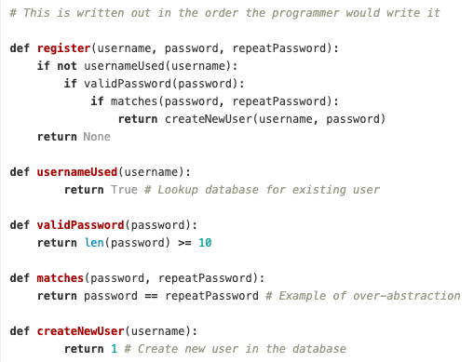
Activity 4:

